Slide 1
Mini Project Course Code:116U01P401
Computer Engineering Semester IV

Slide 2
Course Delivery
Per Week
Theory/ Tutorial: 1 Hr
Laboratory: 2 Hr
Assessment
In Semester Assessment: 50 Marks
End Semester Assessment: 50 Marks
Activity:
At the end of the semester a small working model of a software/ hardware fulfilling requirements

Slide 3
Course Delivery
Faculty In-charges for laboratory (Div A)
Theory/ Tutorial will be conducted together
Name of The Faculty Member | Batch
Grishma Sharma | A1
Kiran thale | A2
Poonam Bhogale | A3

Slide 4
Tutorial/ Theory 1
Definition of a project
Types of projects
Differentiation between a project, product, and a program
Motivation for doing mini project
Hands on experience on development of a product working in a team with constraints of time

Slide 5
Project as a Team activity
Selection of a team:
Method followed by students
Form a group and then select a project
Method to be followed in reality
Decide atopic
Select appropriate team members

Slide 6

Sustainable Development Goals

Slide 7
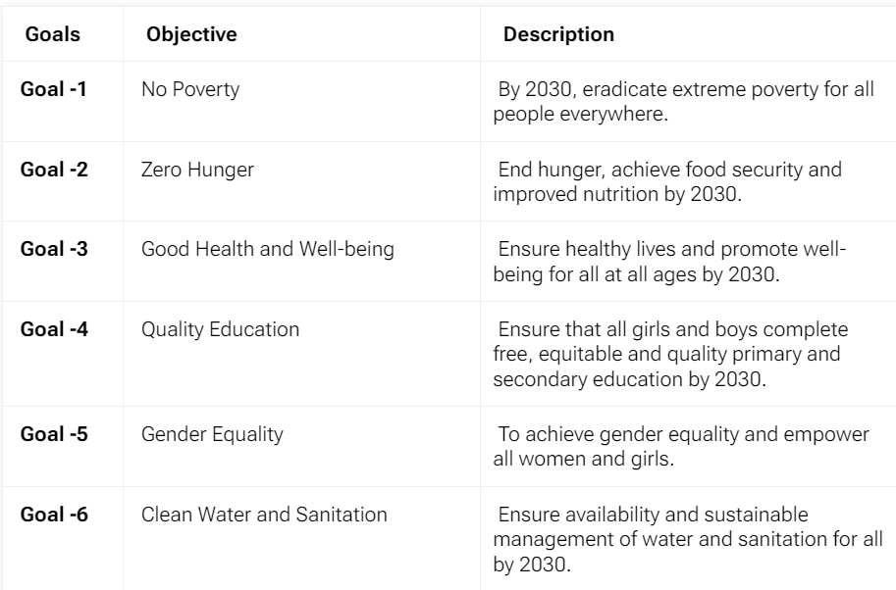
SDG

Slide 8
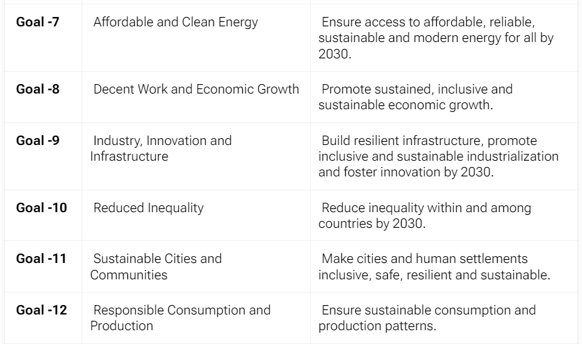
SDG

Slide 9
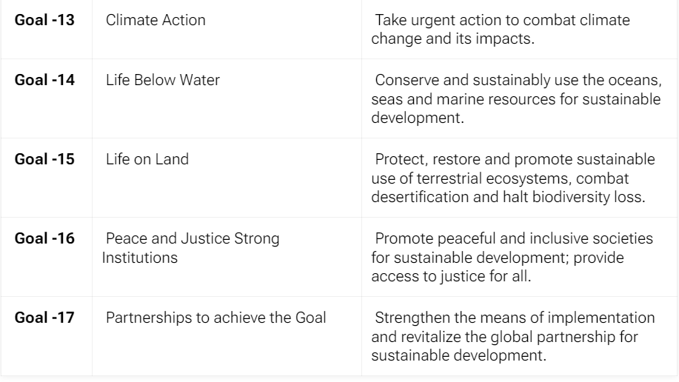
SDG

Slide 10
Timeline of Activities
Duration of the semester: 15 weeks
In semester Assessment:
Mostly close to ISE of other theory examination
End Semester Assessment:
Last week if the semester:
Students should demonstrate
the working model by end of the semester

Slide 11
Line of Action
Select a topic
Select a team
Define the Project
Scope
Team
Deliverables
Plan the Activities
Perform the Activities
Lessons Learnt

Slide 12
Selection of Topic
Your interest, aim
Search what is in demand
Find how others are doing that
Whats RoI

Slide 13
Searching for Topic
Use authentic source for topic
Ways to search
Google
Google Scholar
Browse through various papers/online
Segregate papers
Relevant
Irrelevant
Tabulate the papers/ online documents

